Slide 1
Automating cervical cancer diagnosis

Slide 2
Diagnostic features
Normal
Pre-cancer
Mustard yellow stain
Well defined margin
Uniform dark brown stain
Notes:
Lugol’s iodine, a glycophilic dark brown solution is uptaken by glycogen rich normal cells and turns a normal cervix dark brown. Cervical cancer cells use up all their glycogin due to rapid metabolism and do not uptake the iodine, staining a light mustard yellow.

Slide 3
Project Goals
Using high quality images provided by the POCkeT Colposcope:
Identify normal vs abnormal VIA and VILI images
Identify Lesion Location for removal or biopsy where available
Distinguish between different grades of cervical lesions (high grade vs low grade)
Notes:
The goals of this project is to use high quality acetic acid or lugols iodine images and first of all identify them as normal or abnormal. If abnormal we would then like to identify the lesion location for removal or a biopsy where it is available. We are also looking to distinguish between the different grades of cervical cancer as this can affect treatment decisions. For the remainder of the talk I will be focussing on the first two goals to identify which cervices are normal vs abnormal and if abnormal, identify the lesion location

Slide 4
Feature Extraction and Classification
Segment Cervix ROI
Extract blue channels from RGB image
Extract green channel from RGB image
Remove specular reflection pixel values – where blue>240
Eliminate zero pixel values
Eliminate zero values from image and perform statistical analysis on pixel values (mean, mode, median, variance)
Apply Otsu’s thresholding method to determine threshold level for pixel distribution
Use blue mode and green threshold from the images to train half the data on an SVM machine and use the other half of the data to test the algorithm

Slide 5
Students can also try the above method for all the different color channels and features to compare statistically and select what they think is best

Slide 6
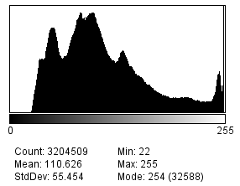
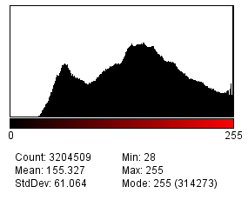
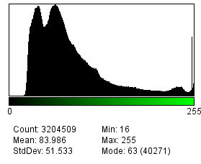
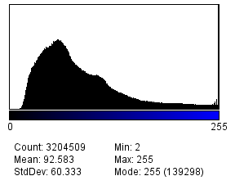
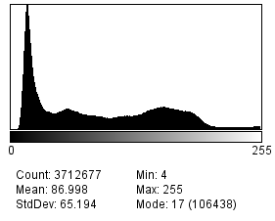
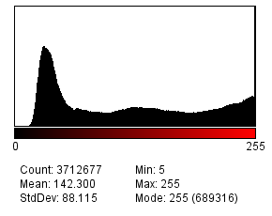
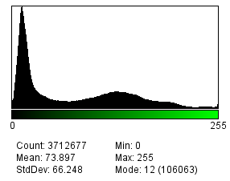
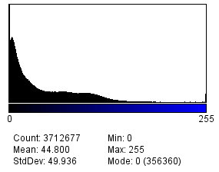
Bases for VILI Feature Extraction (histogram distribution)
Normal
Abnormal

Slide 7
Classification of images using SVM in MATLAB
threshold value

Slide 8
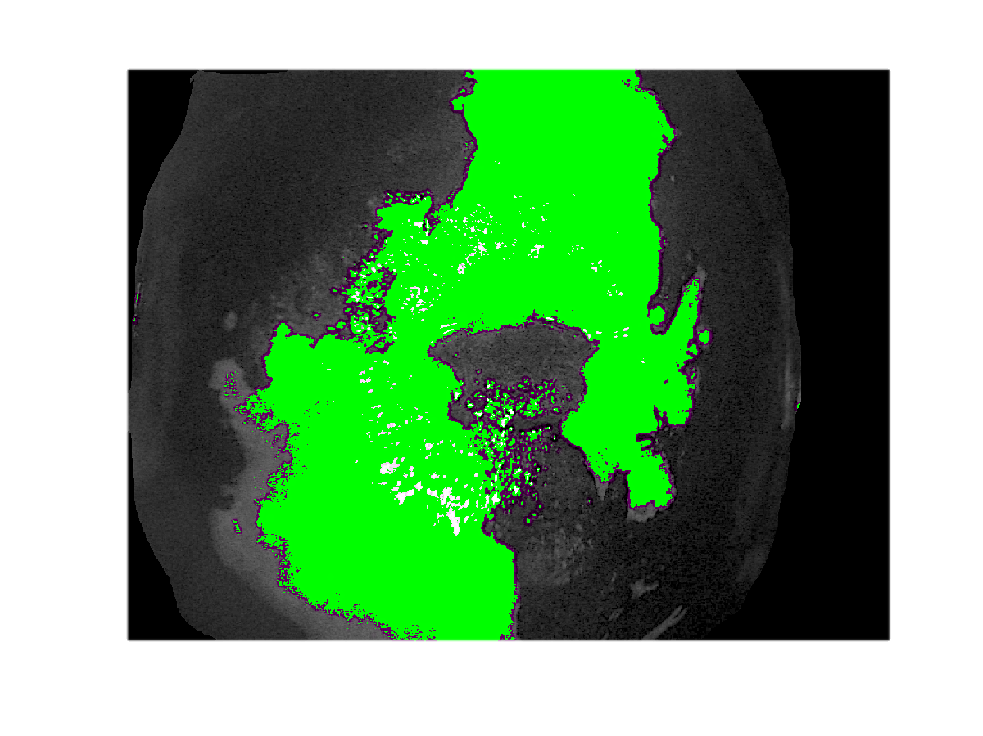
Preliminary Lesion Detection in VILI images with MATLAB

